Slide 1
NASA Space Grant Robotics
Arizona State University
- Emily McBryan -

Slide 2
Goals
Provide students with hands on experience to take what we’ve learned in the class room to real world applications
Provide opportunities for student members for getting internships and jobs
Outreach to make science and technology a larger part of our society

Slide 3
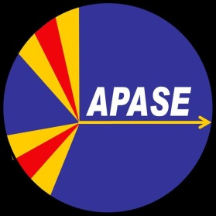


Achieving Goals: Experience
The team is an active club on campus that anyone can join and participate.
We build and control underwater robots to compete at national and international competitions.
  NURC (National Underwater Robotics Challenge)
  MATE (Marine Advance Technology Education)
  AUVSI (Association for Unmanned Vehicle Systems International)

Slide 4
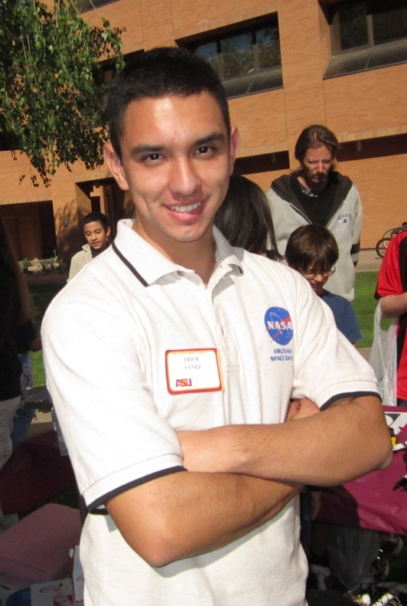
Achieving Goals: Opportunity
Arizona Space Grant Consortium provides funding, facility, and mentors to the NASA Space Grant Robotics team
Student opportunities:
Space Grant internships
  Hands on experience
  Work with experts in the field
  Leadership role and team work experience

Slide 5
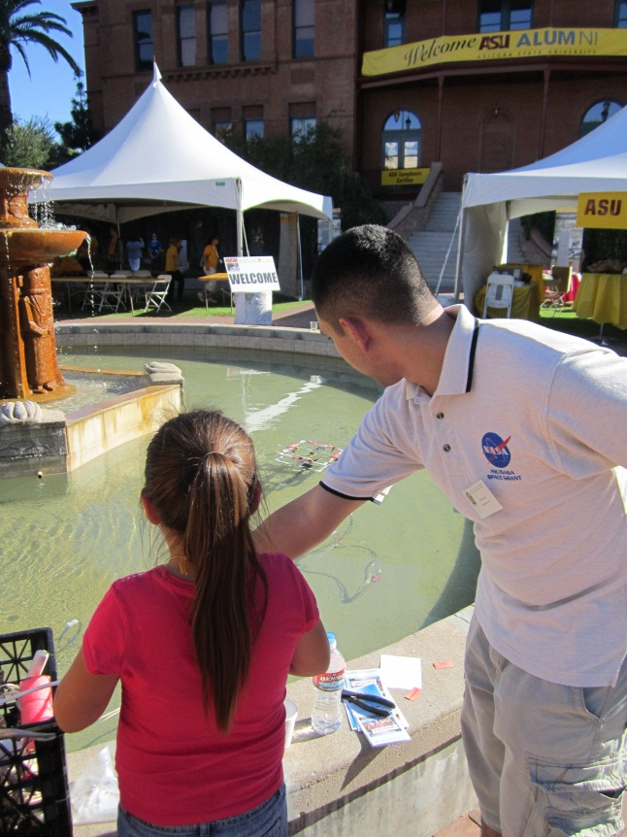
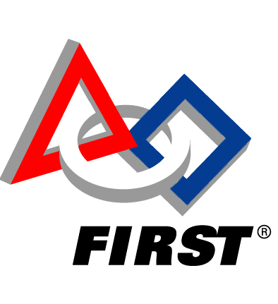
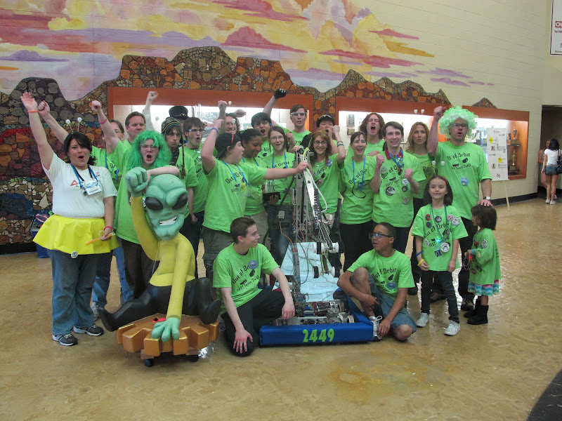
Achieving Goals: Outreach
Mentor FIRST Robotic teams
  High school robotic teams to build at 150lb robot in 6 weeks to compete!
  2012 FIRST game: Robot Rumble!

Slide 6
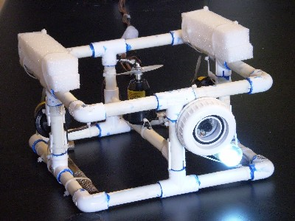
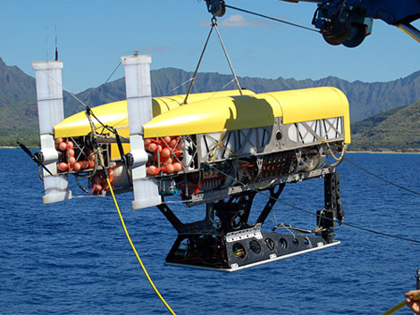
Brief History
What’s in an underwater robot?

Slide 7
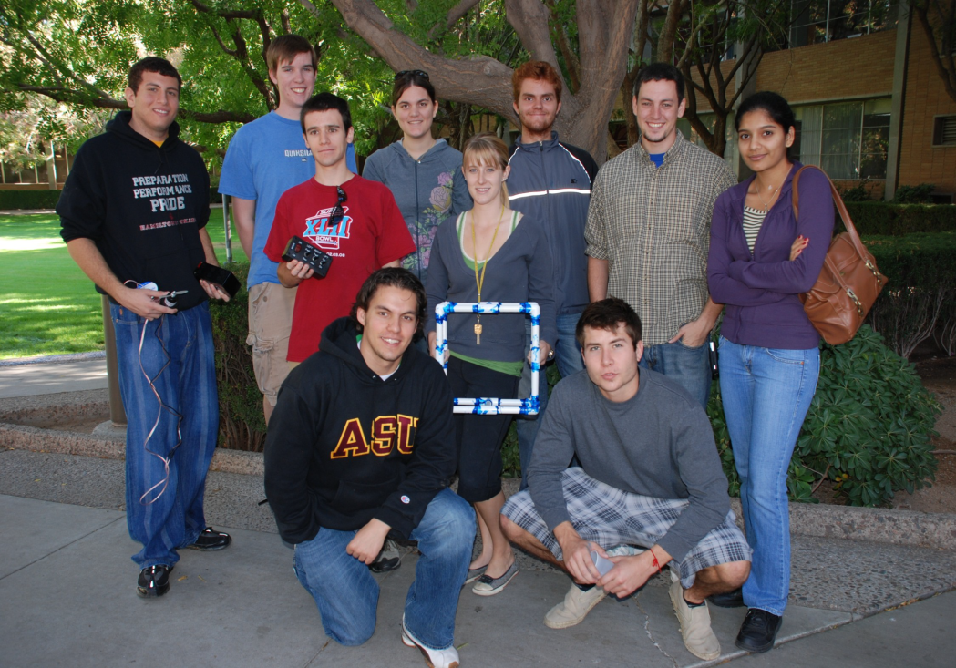
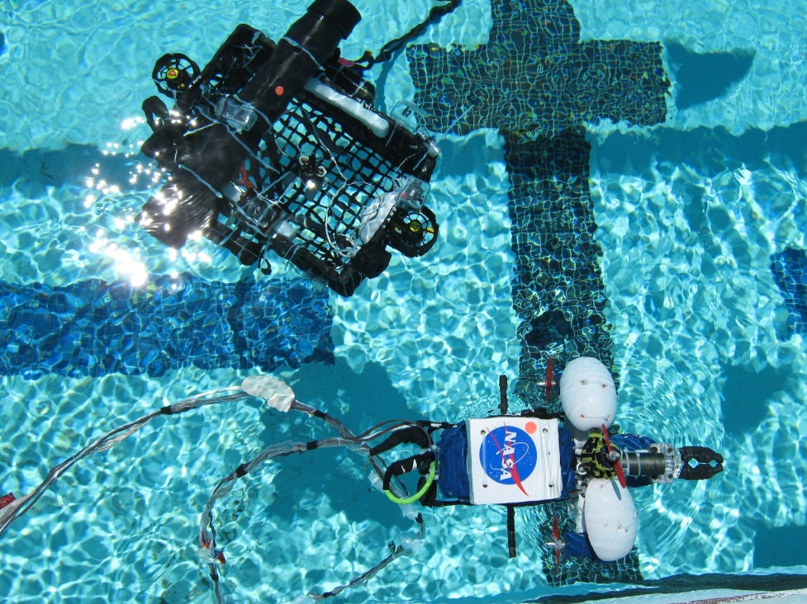
NASA Space Grant Robotics 2009
  2009 team led by Mike Veto competed in the NURC and MATE competition with Aquabot and ROV-Is-A-Box.
  We placed 2nd at NURC and 6th at MATE and won the Aloha award

Slide 8
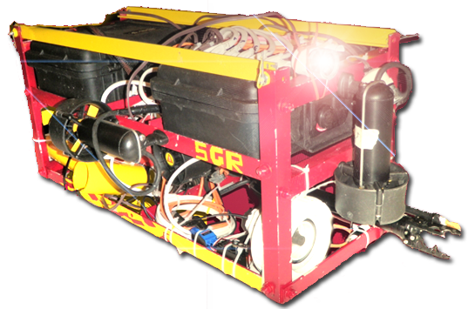
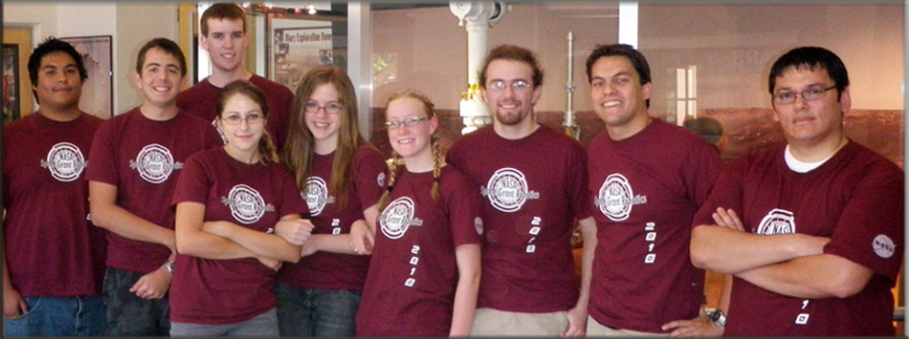
NASA Space Grant Robotics 2010
  Led by Mike Veto, the team competed with Aqua-Devil in the 2010 NURC (taking 2nd ) and MATE competition

Slide 9
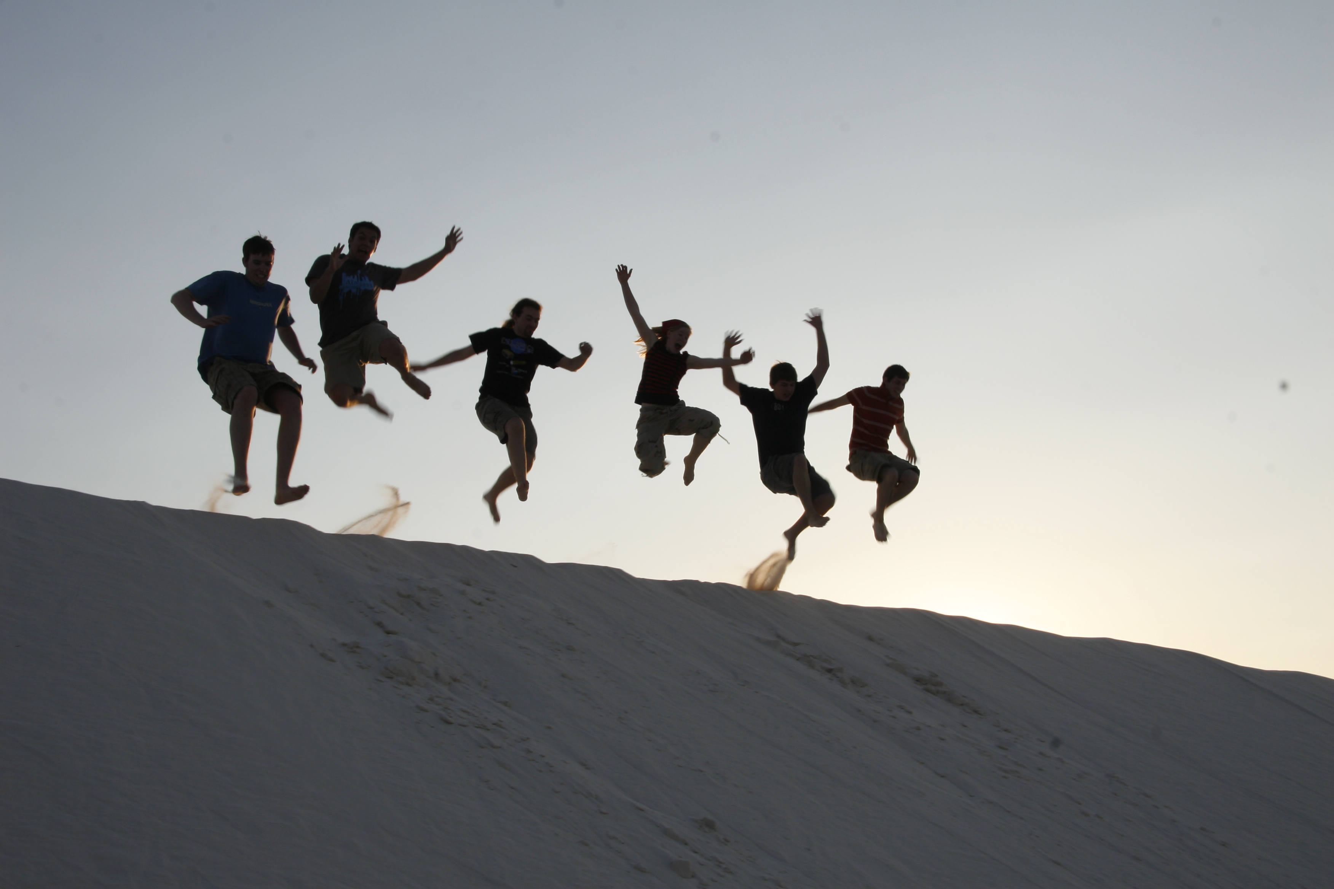
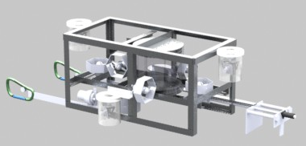
NASA Space Grant Robotics 2011
Led by Emily McBryan GUASS competed in NURC and MATE in 2011 placing 2nd at NURC

Slide 10
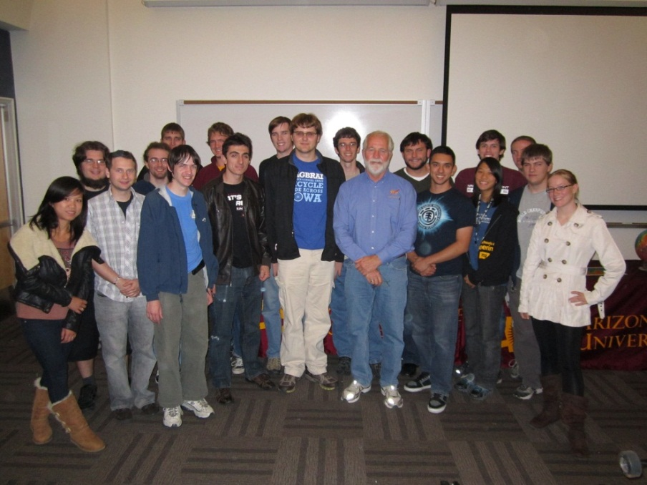
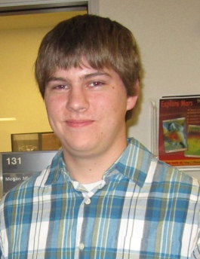
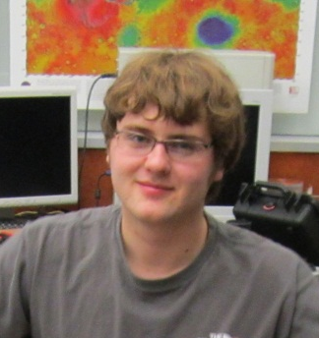
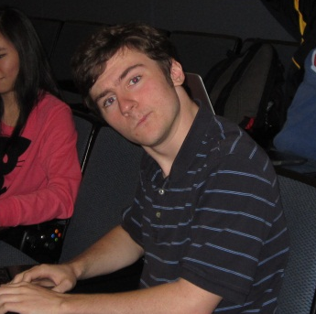
NASA Space Grant 2012
For 2012 the team has expanded to deeper depth by taking on the challenge of autonomy and more advanced robotics!
Jonathon Houda: Lead Mechanical Engineer
Michael Przeslica: Lead Electrical Engineer
Ben Prather: Lead Programming Engineer

Slide 11
2012 Challenges!
NURC – Rescue captured people from an alien vessel
MATE – Survey a sunken WWII vessel
AUVSI – Autonomous mission to take down Julius Caesar

Slide 12
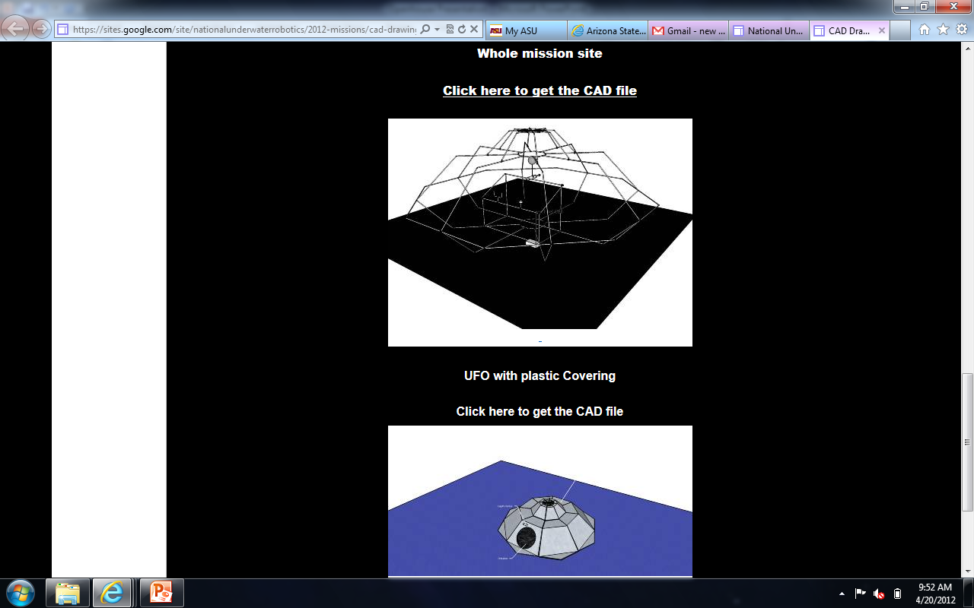
NURC 2012
Rescue mission to a sunken UFO!
“Imagination is more important than knowledge.”

Slide 13
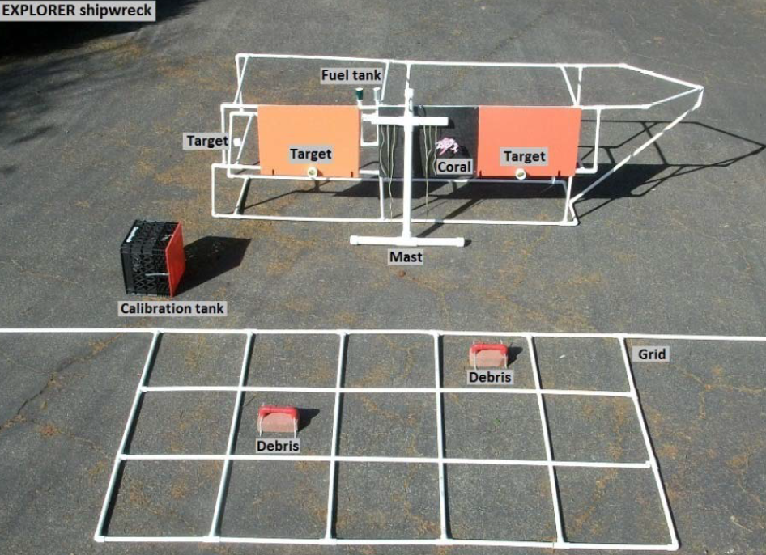
MATE 2012
Survey a sunken WWII vessel
Remove the oil to protect the environment

Slide 14
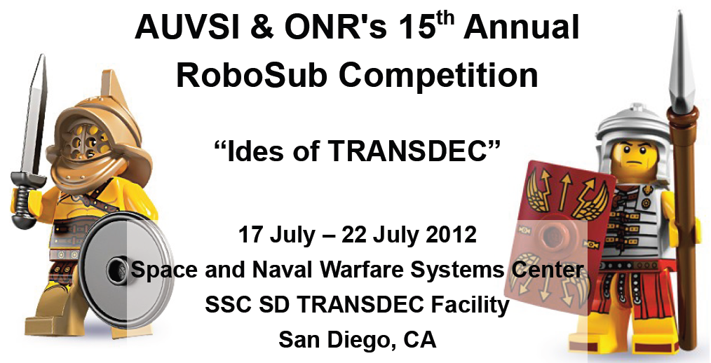
AUVSI 2012

Slide 15
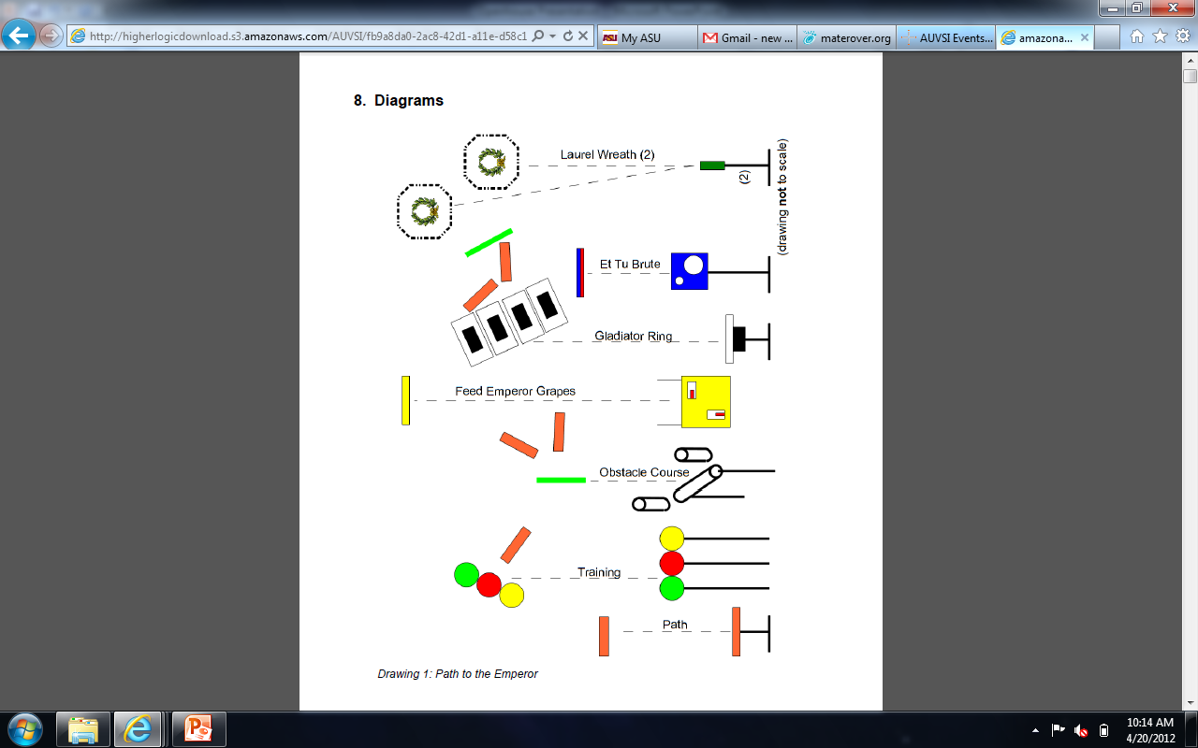
Autonomous Tasks:
Line Following
Sound Recognition
Image Recognition
  Shape
  Color
Target and shoot a torpedo

Slide 16
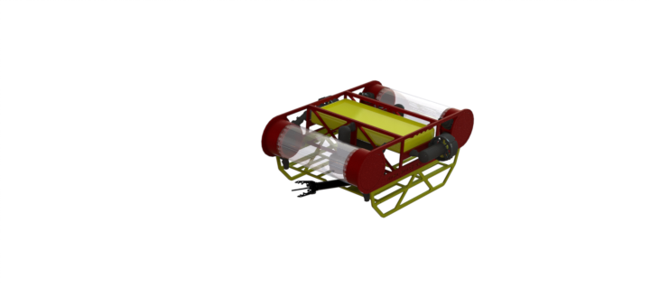
Sneak Peak of 2012 Robot!

Slide 17
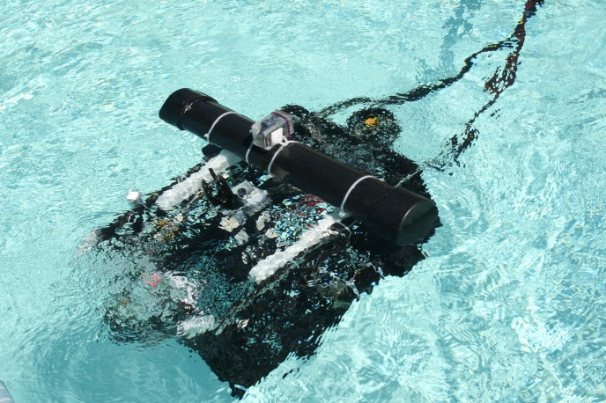
Robotics and Space Grant
Look how much we’ve grown and learned!
Without NASA Space Grant’s constant support and this team would not exist and the lessons learned and the friendships made would never have happened. Thank you Space grant!

Slide 18
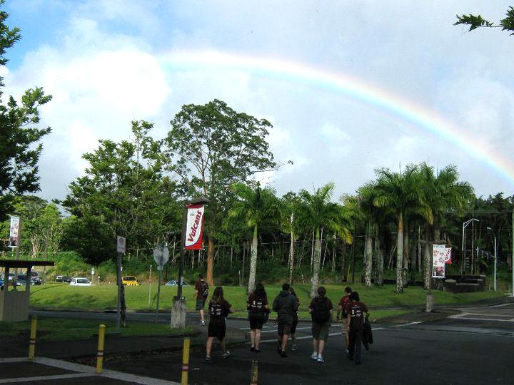
How our lives have been changed due to the Space Grant and due to robotics

Slide 19
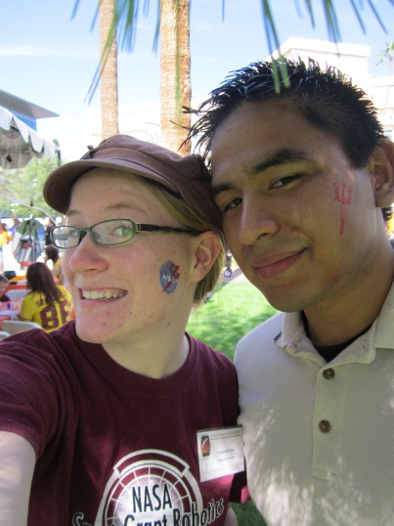
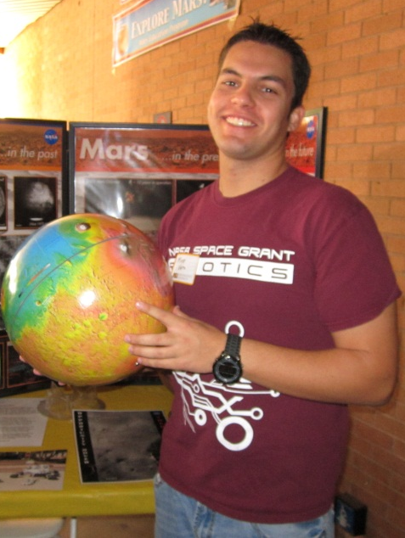
How our lives have been changed due to the Space Grant and due to robotics
“Bringing together a talented group of students to work not only as a team, but as friends.” —Mike Veto
“Seeing designs come to life.” —Alex Kafka
“Learning how to use industry equipment.” — Nick Piacentine
“Providing a single opportunity to hone skills not emphasized in my major.” —Katherine Forsberg
“Working on a hands on engineering project with a real-world goal.”
—Robert Wagner
“Seeing students my own age applying advanced engineering ideas to overcome challenges.” —Emily McBryan

Slide 20
Purposely combining electricity and H20
Questions?

